Slide 1
Database Systems: Design, Implementation, and Management
CHAPTER 13
Data Warehouse
Notes:
1

Slide 2
Chapter Objectives
OLTP Vs. OLAP
What is a Data Warehouse
ROLAP
MOLAP
Star Schema

Slide 3
OLTP Vs. OLAP
Organizations use databases for two purposes:
  Transaction Processing
  Decision Support
So far our discussion has centered around designing a database to support online transaction processing (OLTP).
Online analytical processing (OLAP) provides an environment that supports business modeling and decision making.
Characteristics of data used for OLTP differ from those used for OLAP in three ways.
Notes:
8

Slide 4
Operational Vs. Decision Support Data
Time span
  Operational data capture current transactions.
  Data for decision support often has a time dimension.
Granularity
  Operational data are fine grained, ex: line item in an invoice.
  Decision support data often are aggregated, ex: total sales of a product in a region.
Notes:
9

Slide 5
Operational Vs. Decision Support Data
Dimensionality
  Operational data focus on representing atomic transactions.
  Decision support data are analyzed from multiple dimensions (business perspectives), ex: product, region, time, etc.

Slide 6
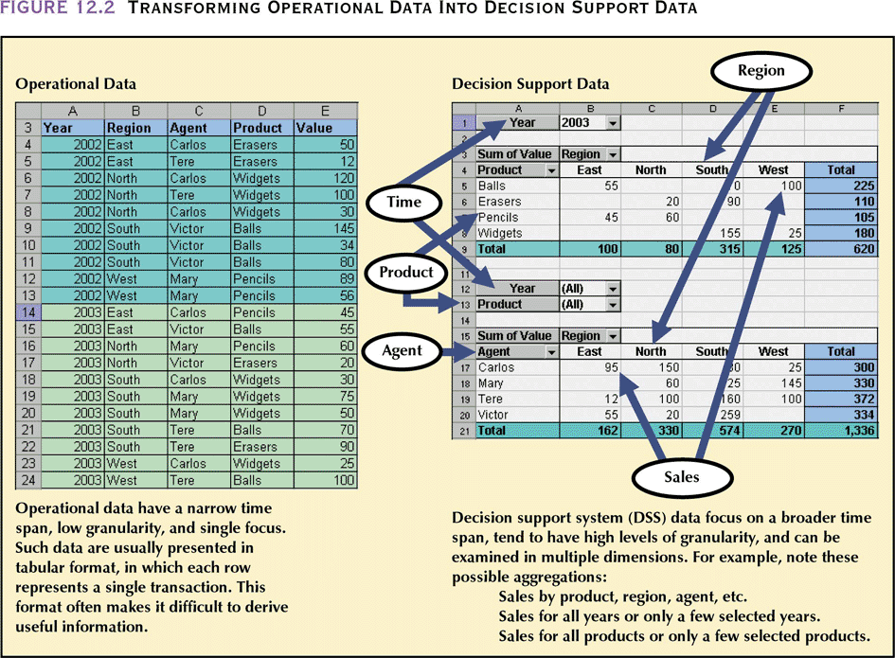
Operational Vs. Decision Support Data

Slide 7
The Data Warehouse
The Data Warehouse is an integrated, subject-oriented, time-variant, non-volatile database that provides support for decision making.
  Integrated
    The Data Warehouse is a centralized, consolidated database that integrates data retrieved from the entire organization.
  Subject-Oriented
    The Data Warehouse data is arranged and optimized to provide answers to questions coming from diverse functional areas within a company.
Notes:
13

Slide 8
The Data Warehouse
  Time Variant
    The Warehouse data represent the flow of data through time. It can even contain projected data.
  Non-Volatile
    Once data enter the Data Warehouse, they are never removed.
    The Data Warehouse is always growing.
Notes:
14

Slide 9
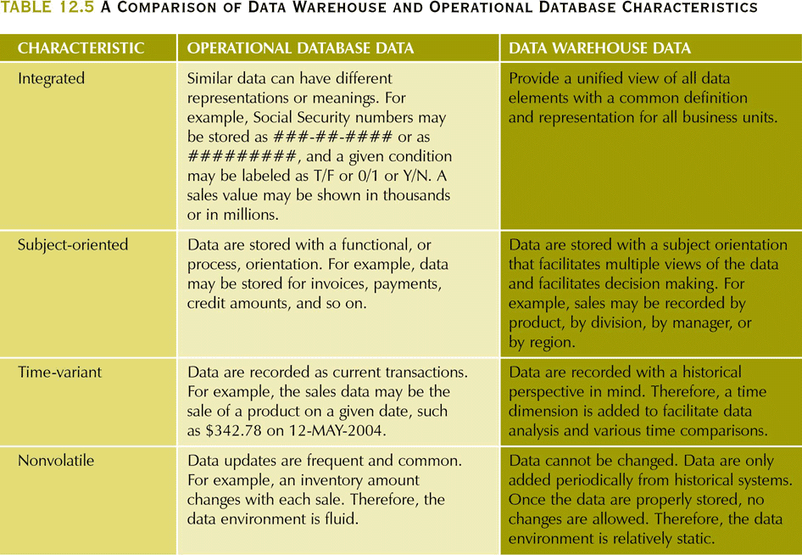
The Data Warehouse

Slide 10
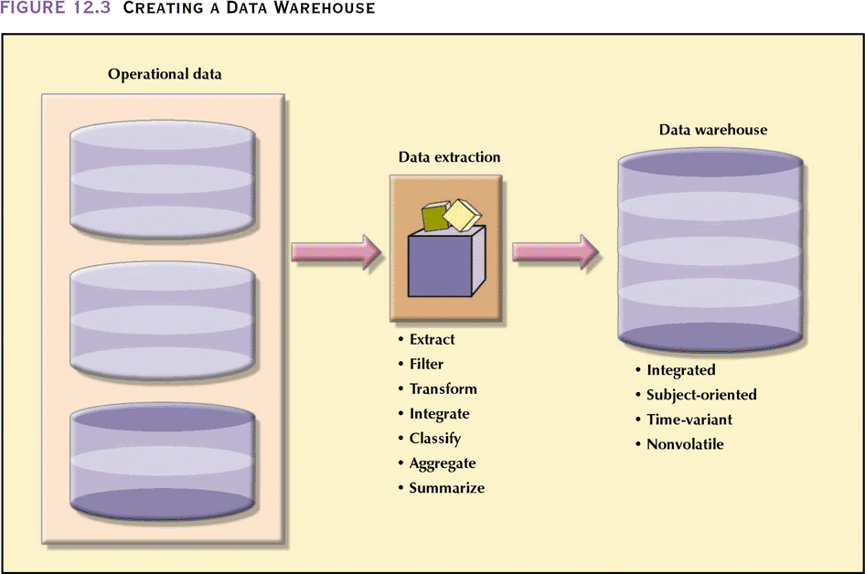
Notes:
16

Slide 11
The Data Warehouse
Data Mart
  A data mart is a small, single-subject data warehouse subset that provides decision support to a small group of people.
  Data Marts can serve as a test vehicle for companies exploring the potential benefits of Data Warehouses.
  Data Marts address local or departmental problems, while a Data Warehouse involves a company-wide effort to support decision making at all levels in the organization.
Notes:
17

Slide 12
On-Line Analytical Processing
Data Warehouses are designed to be used for OLAP.
Two popular OLAP techniques are
  Relational OLAP (ROLAP)
    Uses a relational database as the back end
  Multidimensional OLAP (MOLAP)
    Uses a multidimensional database as the back end
Notes:
23

Slide 13
ROLAP
Relational On-Line Analytical Processing (ROLAP) provides OLAP functionality by using relational database and familiar relational query tools.
Extensions to RDBMS
  Multidimensional data schema support within the RDBMS
  Data access language and query performance optimized for multidimensional data
  Support for very large databases
Notes:
35

Slide 14
ROLAP
Multidimensional Data Schema Support within the RDBMS
  Decision support data tend to be non-normalized, duplicated, and pre- aggregated.
  Normalization of tables in relational technology is seen as a stumbling block to its use in OLAP systems.
  ROLAP uses a special design technique to enable RDBMS technology to support multidimensional data representations, known as star schema.
  Star schema creates the near equivalent of a multidimensional database schema from the existing relational database.

Slide 15
ROLAP
Data Access Language and Query Performance Optimized for Multidimensional Data
  Most decision support data requests require the use of multiple-pass SQL queries or multiple nested SQL statements.
  ROLAP extends SQL so that it can differentiate between access requirements for data warehouse data and operational data.

Slide 16
ROLAP
Support for Very Large Databases
  Decision support data are normally loaded in bulk (batch) mode from the operational data.
  RDBMS must have the proper tools to import, integrate, and populate the data warehouse with operational data.
  The speed of the data-loading operations is important.

Slide 17
MOLAP
MOLAP extends OLAP functionality to multidimensional databases (MDBMS).
MDBMS end users visualize the stored data as a multidimensional cube known as a data cube.
Data cubes are created by extracting data from the operational databases or from the data warehouse.
Data cubes are static and require front-end design work.
To speed data access, data cubes are normally held in memory, called cube cache.
MOLAP is generally faster than their ROLAP counterparts. It is also more resource-intensive.
Significant up front design effort is required because of lack of flexibility of the database.
MDBMS is best suited for small and medium data sets (under 50 GB).
Notes:
37

Slide 18
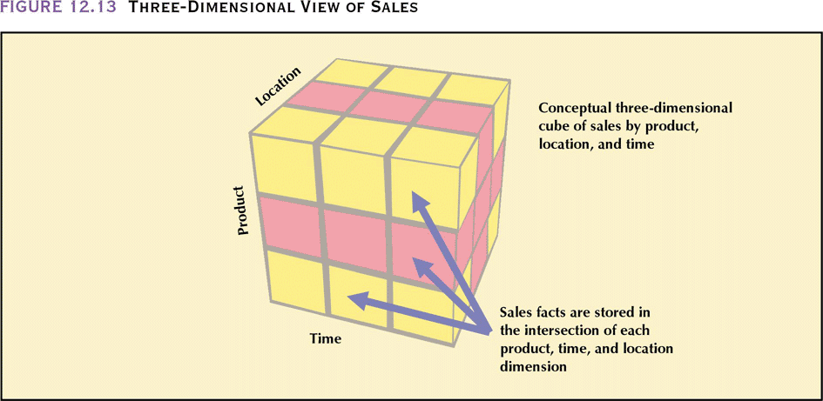
Notes:
46

Slide 19
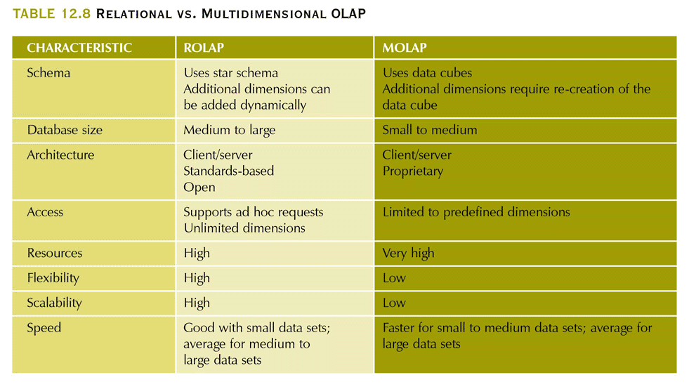
Relational Vs. Multidimensional OLAP
Notes:
39

Slide 20
Star Schema
The star schema is a data-modeling technique used to map multidimensional decision support into a relational database.
Star schemas yield an easily implemented model for multidimensional data analysis while still preserving the relational structure of the operational database.
Four Components:
  Facts
  Dimensions
  Attributes
  Attribute hierarchies
Notes:
40

Slide 21
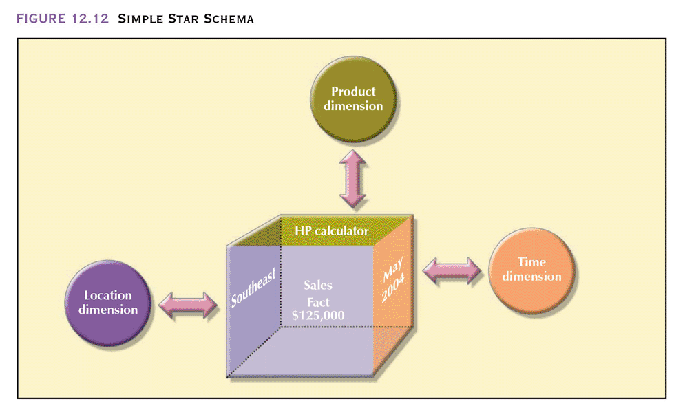
A Simple Star Schema
Notes:
42

Slide 22
Star Schema
Facts
  Facts are numeric measurements (values) that represent a specific business aspect or activity.
  The fact table contains facts that are linked through their dimensions.
  Facts can be computed or derived at run-time (metrics).
Dimensions
  Dimensions are qualifying characteristics that provide additional perspectives to a given fact.
  Dimensions are stored in dimension tables.
Notes:
41

Slide 23
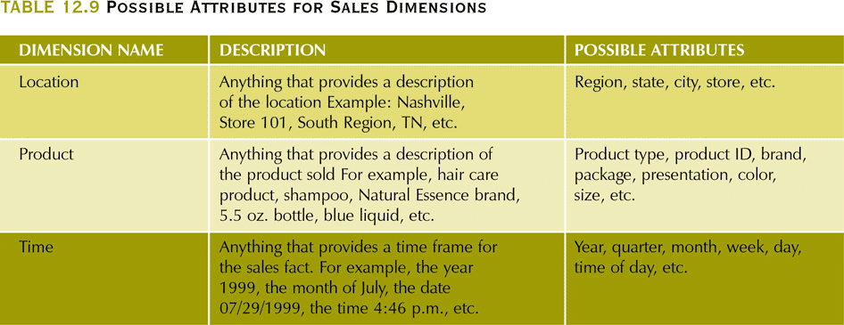
Star Schema
Attributes
  Each dimension table contains attributes. Attributes are often used to search, filter, or classify facts.
  Dimensions provide descriptive characteristics about the facts through their attributes.
Notes:
45

Slide 24
Three Dimensional View Of Sales
Notes:
46

Slide 25
Star Schema
Attribute Hierarchies
  Attributes within dimensions can be ordered in a well-defined attribute hierarchy.
  The attribute hierarchy provides a top-down data organization that is used for two main purposes:
    Aggregation
    Drill-down/roll-up data analysis
Notes:
48

Slide 26
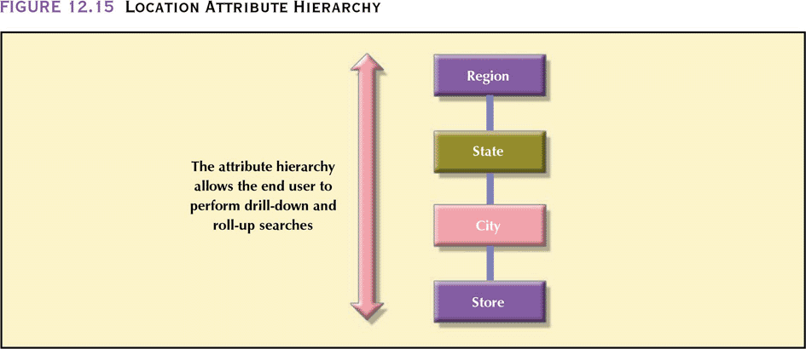
A Location Attribute Hierarchy
Notes:
49

Slide 27
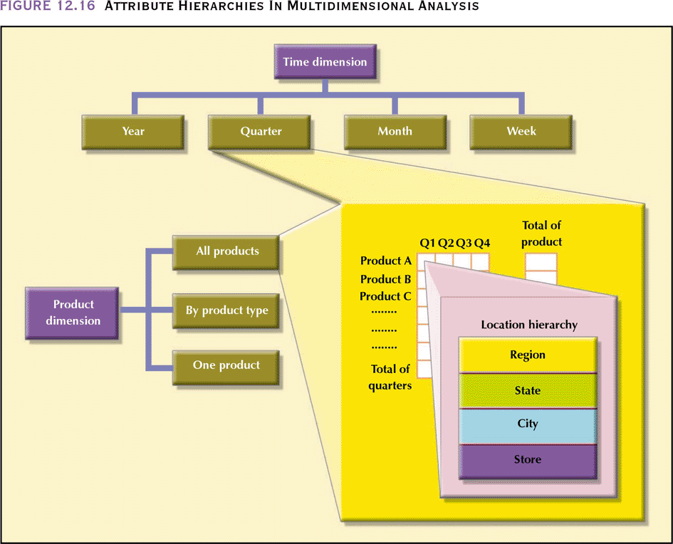
Attribute Hierarchies In Multidimensional Analysis
Notes:
50

Slide 28
Star Schema
Star Schema Representation
  Facts and dimensions are normally represented by physical tables in the data warehouse database.
  The fact table is related to each dimension table in a many-to-one (M:1) relationship.
  Fact and dimension tables are related by foreign keys and are subject to the primary/foreign key constraints.
Notes:
51

Slide 29
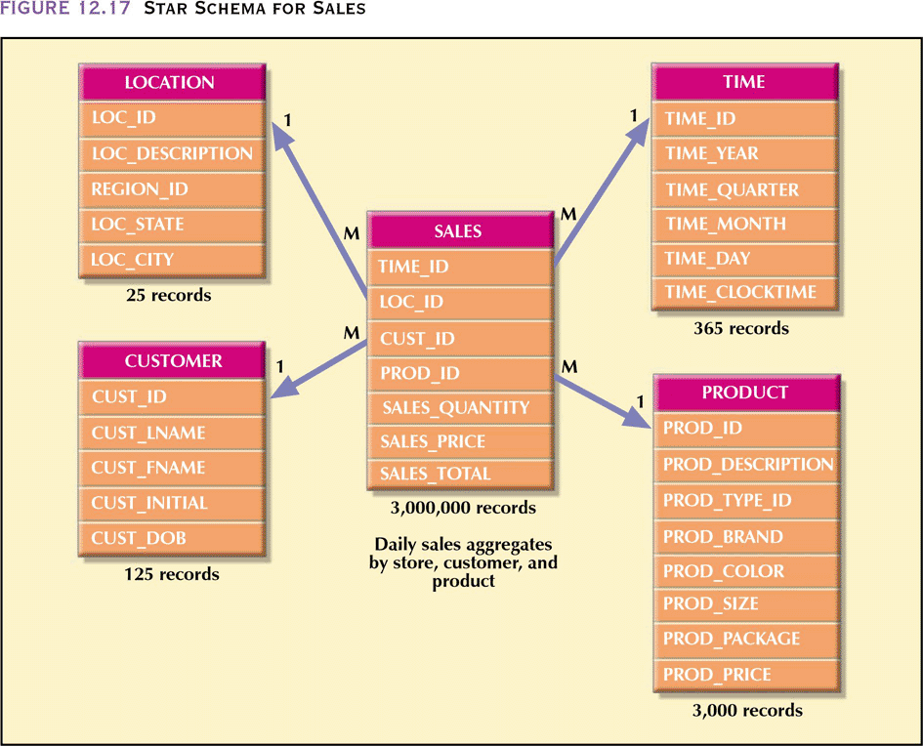
Notes:
52

Slide 30
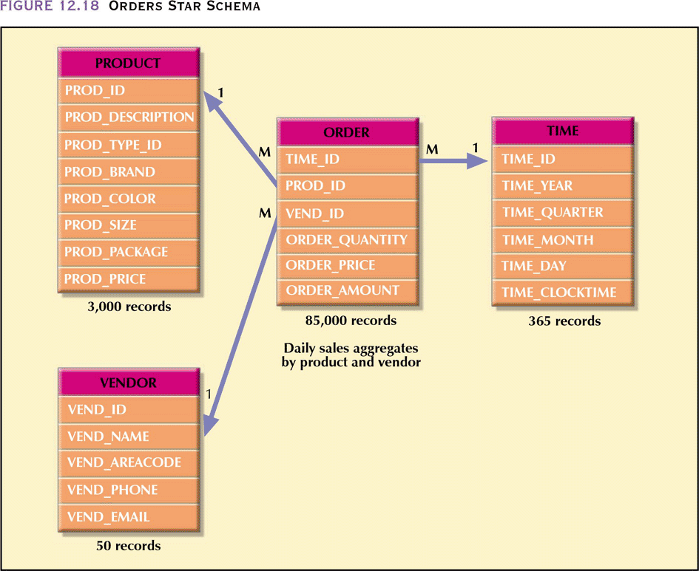
Notes:
53

Slide 31
Star Schema Performance Improvement
Four techniques are use to optimize data ware house design:
  Normalization of dimensional tables
  Multiple fact tables at different aggregation levels
  Denormalization of fact tables
  Table partitioning and replication (As covered in Distributed DB)

Slide 32
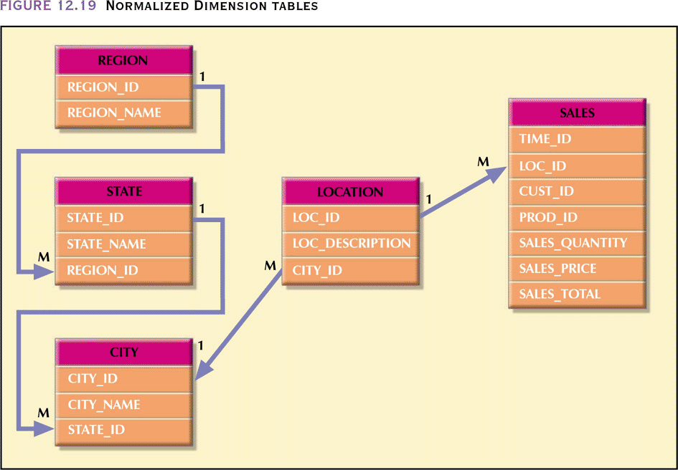
Normalizing Dimensional Tables
Location dimension in Fig 12.17 has transitive dependencies.
Normalizing it to 3NF will simplify the structure, but will increase the complexity of querying through multi-table joins

Slide 33
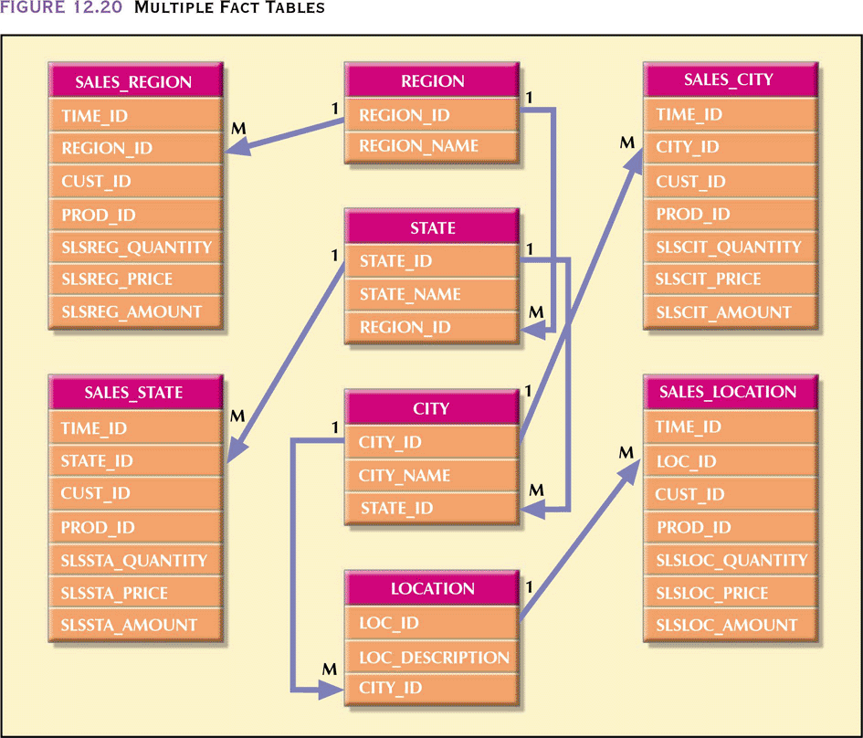
Multiple Fact Tables
Maintaining multiple fact tables at different levels of aggregation will speed up some queries
The levels of aggregation must be determined at the time of DW design keeping in mind the load pattern

Slide 34
Denormalizing Fact Tables
Denormalization improves performance by using a single record to store data that may take many records.
For example, to facilitate comparison of total sale by product groups across time, a Year_Totals table may contain the following columns: Year_ID, Month_1, Month_2,… Month_12, and Year_Total

